Slide 1
CMSC204
Kartchner
V(StateGraph) = {Oregon, Alaska, Texas, Hawaii, Vermont, NewYork, California}
E(StateGraph) = {(Alaska, Oregon), (Hawaii, Alaska), (Hawaii, Texas), (Texas, Hawaii), (Hawaii, California), (Hawaii, New York), (Texas, Vermont), (Vermont, California), (Vermont, Alaska)}
1. Draw the StateGraph
Oregon
Alaska
New York
California
Hawaii
Texas
Vermont

Slide 2
a. Show the adjacency matrix that would describe the edges in the graph. Store the vertices in alphabetical order
States
Alaska
California
Hawaii
New York
Oregon
Texas
Vermont
0 0 0 0 1 0 0
0 0 0 0 0 0 0
1 1 0 1 0 1 0
0 0 0 0 0 0 0
0 0 0 0 0 0 0
0 0 1 0 0 0 1
1 1 0 0 0 0 0
3. b. Show the adjacency lists
that would describe the edges in the graph
Alaska
California
Hawaii
New York
Oregon
Texas
Vermont
OR
AL
CA
NY
TX
VT
HI
AL
CA

Slide 3
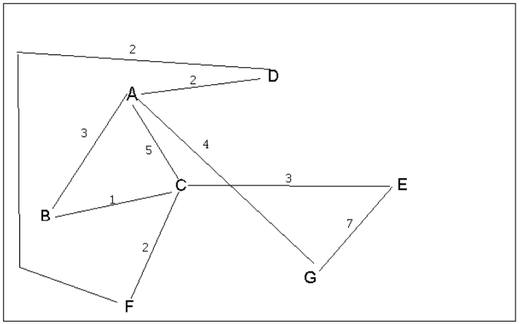
4 a. Which of the following lists the graph nodes in depth first order beginning with E?
A) E, G, F, C, D, B, A
B) G, A, E, C, B, F, D
C) E, G, A, D, F, C, B
D) E, C, F, B, A, D, G
4 b. Which of the following lists the graph nodes in breadth first order beginning at F?
A) F, C, D, A, B, E, G
B) F, D, C, A, B, C, G
C) F, C, D, B, G, A, E
D) a, b, and c are all breadth first traversals

Slide 4
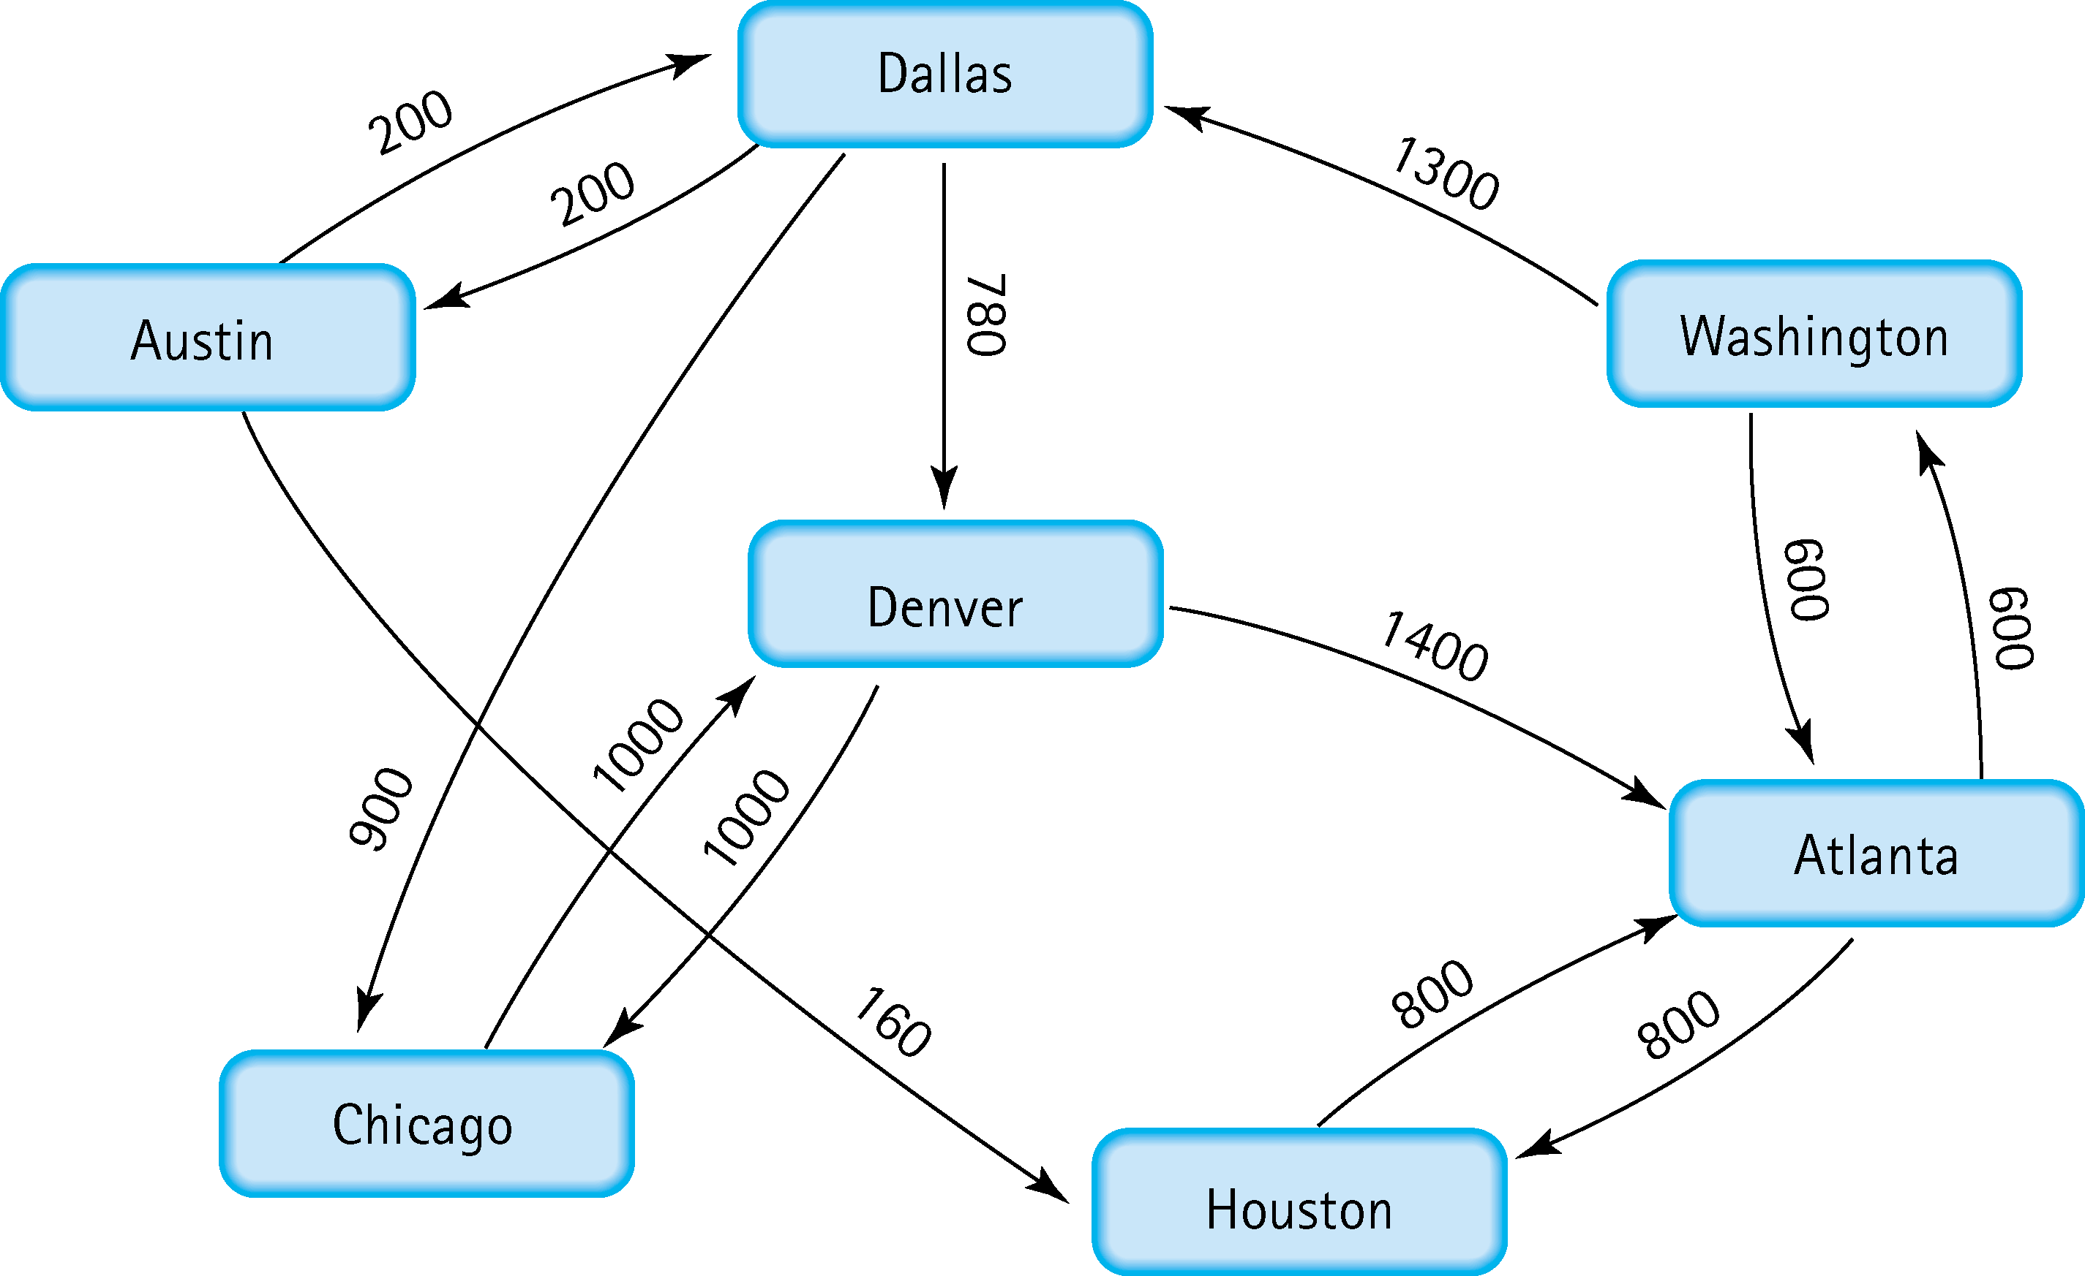
5. Find the shortest distance from Atlanta to every other city
Atlanta to Washington 600
Atlanta to Houston 800
Atlanta to Denver 1900
Atlanta to Chicago 2800
Atlanta to Austin 2100
Atlanta to Dallas 1900

Slide 5
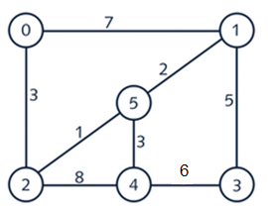
6. Find the minimal spanning tree using Prim’s algorithm. Use
0 as the source vertex . Show the steps.

Slide 6
7. Find the minimal spanning tree using Kruskal’s algorithm.
Show the weights in order and the steps.

Slide 7
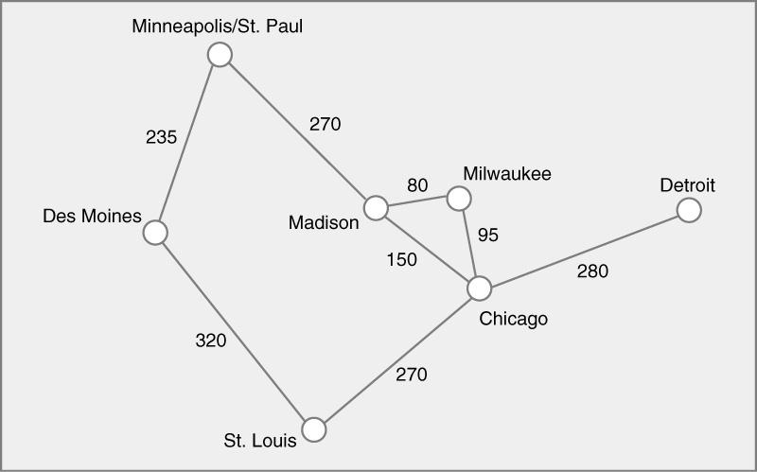
8. Find the minimal spanning tree using the algorithm you prefer. Use
Minneapolis/St. Paul as the source vertex

Slide 8
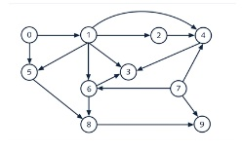
9. List the nodes of the graph in a breadth first topological ordering. Show the
steps using arrays predCount, topologicalOrder and a queue
predCount
0 1 1 3 3 2 2 0 2 2
queue
0 7
topologicalOrder
predCount
0 0 1 3 3 1 2 0 2 2
queue
7
topologicalOrder
0

Slide 9
predCount
0 0 1 3 2 1 1 0 2 1
queue
1
topologicalOrder
0 7
predCount
0 0 0 2 1 0 0 0 2 1
queue
2 5 6
topologicalOrder
0 7 1
predCount
0 0 0 2 1 0 0 0 2 1
queue
2 5 6
topologicalOrder
0 7 1
predCount
0 0 0 2 0 0 0 0 2 1
queue
5 6
topologicalOrder
0 7 1 2

Slide 10
predCount
0 0 0 2 0 0 0 0 1 1
queue
6
topologicalOrder
0 7 1 2 5
predCount
0 0 0 1 0 0 0 0 0 1
queue
topologicalOrder
0 7 1 2 5 6
predCount
0 0 0 1 0 0 0 0 0 1
queue
4 8
topologicalOrder
0 7 1 2 5 6
predCount
0 0 0 0 0 0 0 0 0 1
queue
8
topologicalOrder
0 7 1 2 5 6 4

Slide 11
predCount
0 0 0 0 0 0 0 0 0 0
queue
3 9
topologicalOrder
0 7 1 2 5 6 4 8
predCount
0 0 0 0 0 0 0 0 0 0
queue
topologicalOrder
0 7 1 2 5 6 4 8 3 9

Slide 12
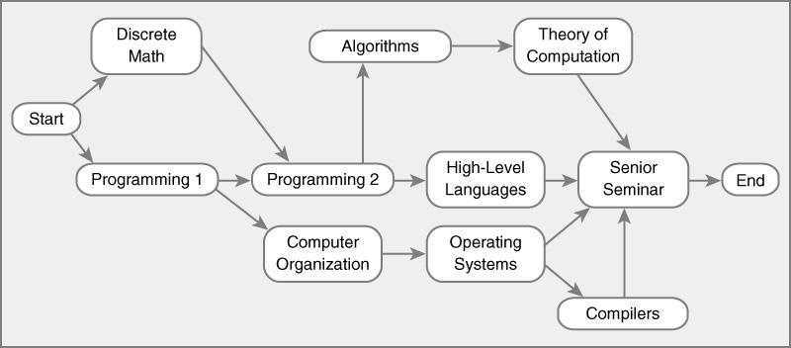
10. List the nodes of the graph in a breadth first topological ordering.
Order:
start, Discrete Math, Programming 1, Computer Organization, Programming 2, Operating Systems, Algorithms, High-Level Languages, Compilers, Theory of Computation, Senior Seminar, End

